Slide 1
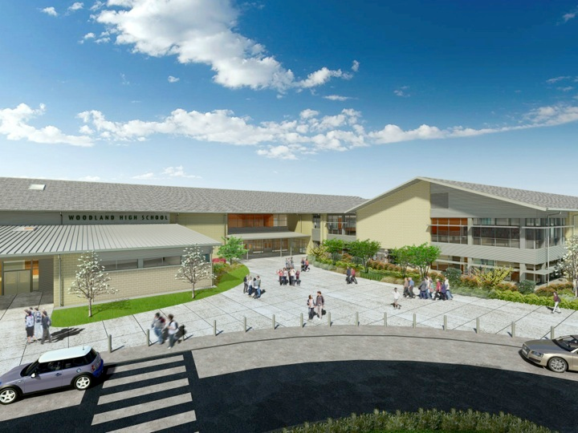
Woodland Public Schools
Facilities and Safety Report
February 2019

Slide 2
FACILITIES REPORT
Improved Pedestrian Crossing The City is applying for the “School Route Improvement Project Grant”. This grant improves visibility and signage by adding illuminated lights and flashers in select areas of the town. This is to address the poor visibility in areas of high risk. The areas being addressed concern:
Approach to WIS parking lot (east and west).
Traffic circle at Lewis River and E. Scott Ave (all directions).
Lewis River Rd. and Pacific Ave. near freeway onramp, southbound.
Buckeye and Park Streets.
Park Street at pedestrian crossing by library.
This project will significantly improve student safety. I have issued a letter of support for the project on behalf of the School District. The City is also requesting a contribution of $5k from the School District.
Office Approach Cameras
My team has started installing office approach monitors and cameras this week. This project further improves the school offices’ visibility of persons approaching the school for access. This will be a dedicated camera/monitor visible 100% of the time to the school office staff. These cameras will allow office staff to quickly ascertain behavior.

Slide 3
FACILITIES REPORT
Bus Parking KWRL
KWRL has requested expansion of the bus parking further into the WMS campus on the south side of their current facility, adjacent to the railroad tracks. This expansion is to support a number of new buses being parked in Woodland, that would exceed our existing capacity for bus and employee parking.
Water Piping WPS
Another large section of galvanized water piping in WPS will have to be replaced this summer. Fifteen months ago we replaced a large section on the west side of the 1st grade wing. The pipe in question spans 7 classrooms on the north, south and east sides of the building. The leaks thus far, seem to originate from inclusions in the piping during the manufacturing process, and show up as pinholes. We have been able to manage these leaks with stainless steel pipe clamps. We will continue to monitor this piping closely through the balance of the school year.
Water Heater WMS
The main water heater for the Yellow Hall has failed internally. This is the primary heater for the kitchen and domestic loads throughout this wing of the school. A new heater was ordered and will be installed during the spring break period.
Security Cameras WIS
Two new security cameras were added to provide additional visibility to the covered play area and the access gate on Salmon Street.

Slide 4
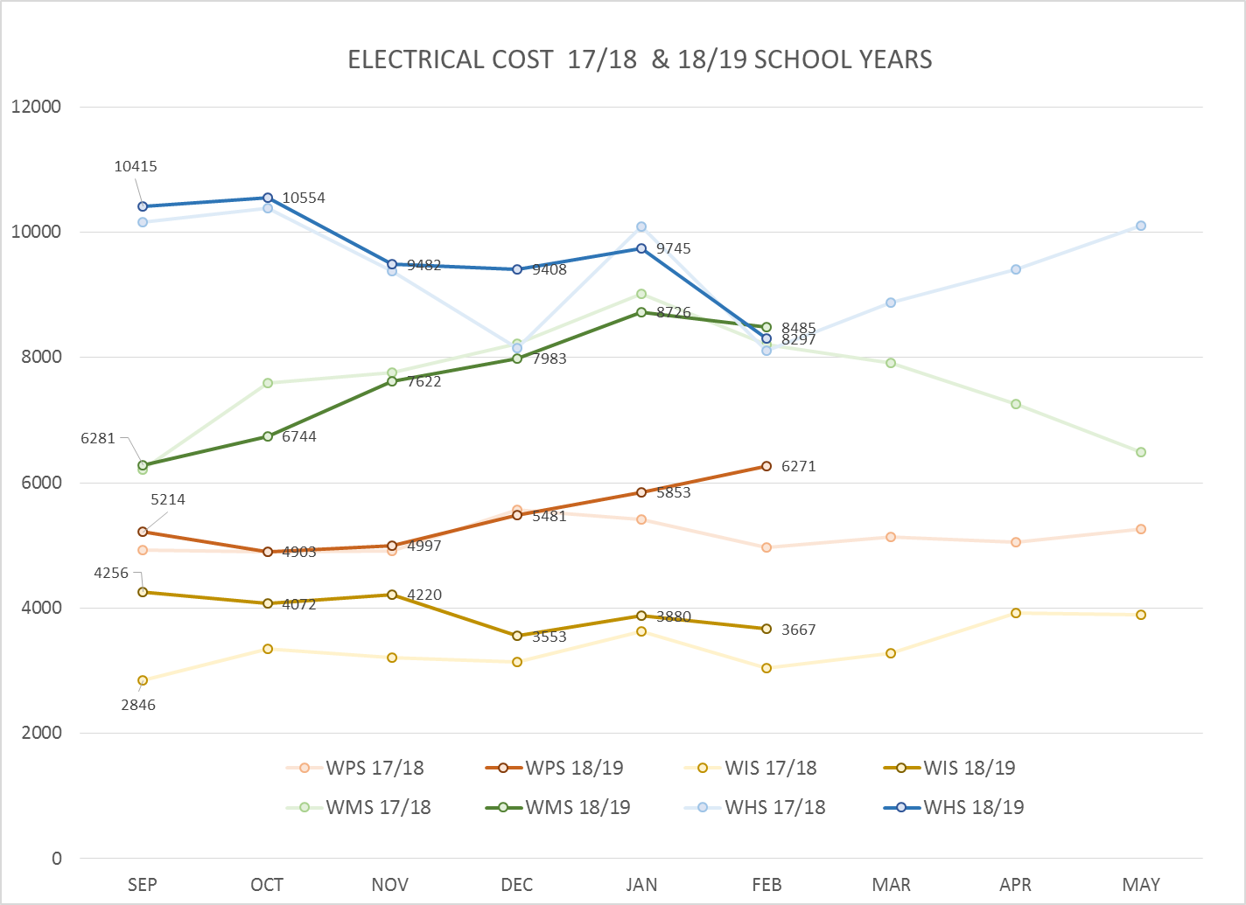
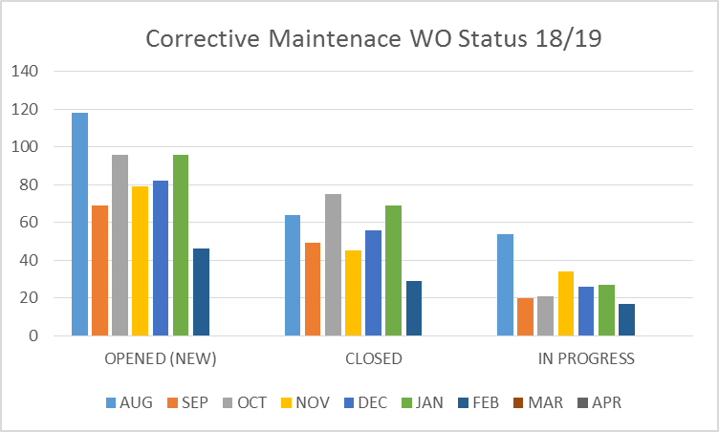
FACILITY CHARTS – POWER COST AND WORK ORDER STATUS
Investigating power
spike WPS

Slide 5
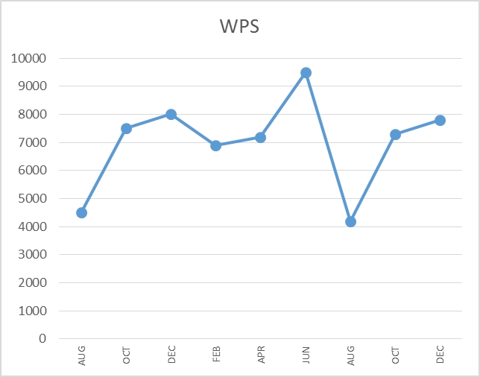
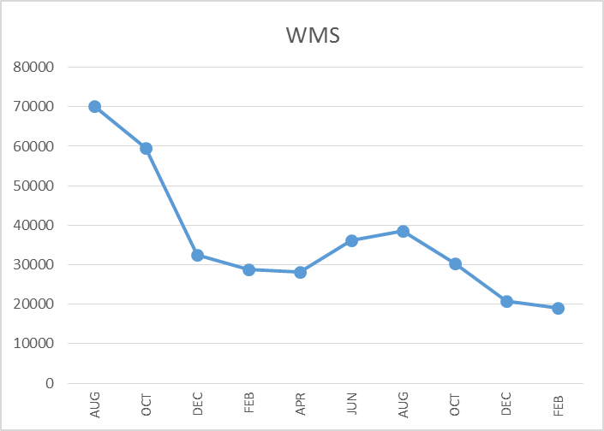
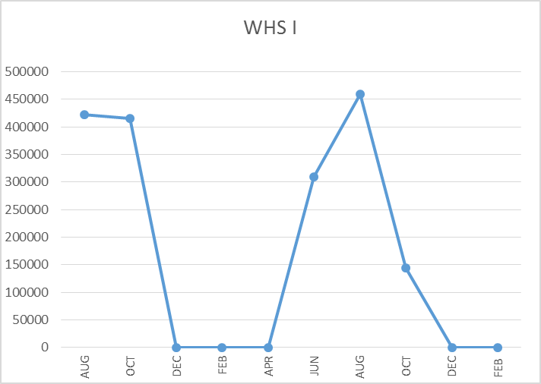
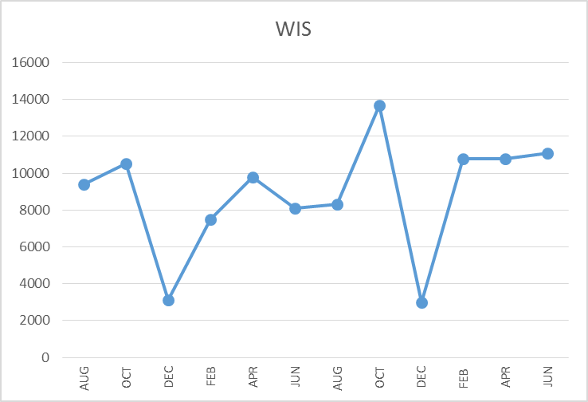
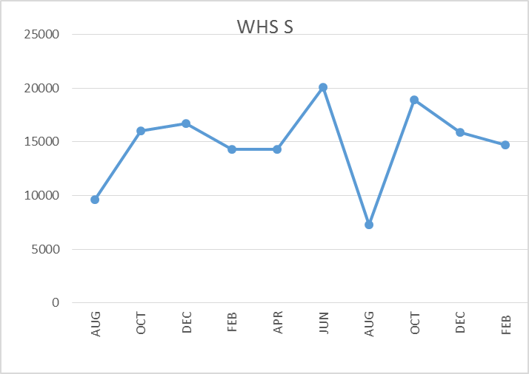
FACILITY CHARTS –
WATER USAGE
WHS, WIS, WMS, WPS
Note
Water charts are updated every two
months. Next update to these charts
in May 2019.
The WMS chart has been reconfigured to include the following 7 meters: 755 Park high and low flow, BO and Team High, PIT house, bus barn, athletic field and DO. All of these meters are totaled on the WMS graph, but each data point is recorded separately to aid in identifying leaks.

Slide 6
SAFETY DATA
Accidents for the Month
There were 20 accidents/incidents for the month; 9 staff and 11 students.
Staff Accidents/Incidents
WHS - Staff opened steam oven while too close; light burn to face.
WIS - Staff opened freezer door, bent down then stood upright and hit head on door.
WIS - Staff member was bitten during de-escalation activities.
WPS – (6) staff members received minor injuries during de-escalation activities.
Student Accidents/Injuries
PIT - Student slipped in snow, bruised buttocks.
PIT - Student suffered Gran Mal seizure; seizure protocol followed.
WIS - Student suffered breathing difficulty after coughing; 911 dispatched.
WMS - Student sprained pinky in Basketball game.
WHS - Student collided with another during baseball game; head injury.
WHS - Student crushed finger between two chairs; lacerated finger.
WHS - Student running to get ball; sprained ankle.
WHS - Student ate 5 pencils; released to guardian for observation.
Yale - Student slipped on gym floor with wet snow boots; scraped chin.
Yale - Student contact in gym forced student into wall; head injury.
Yale - Student ran into classroom and slipped; head injury above eye.

Slide 7
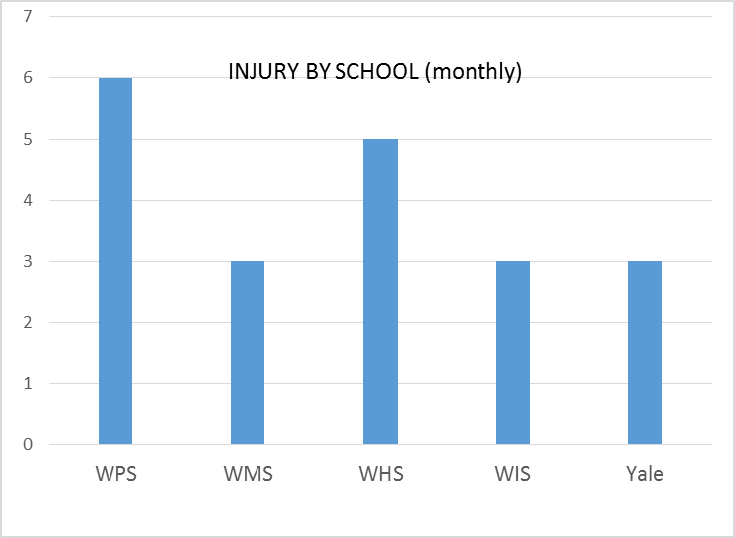
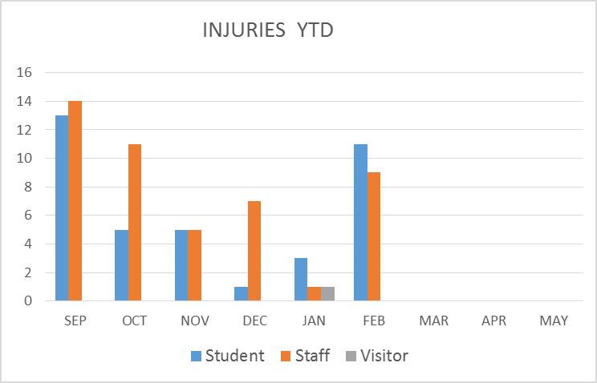
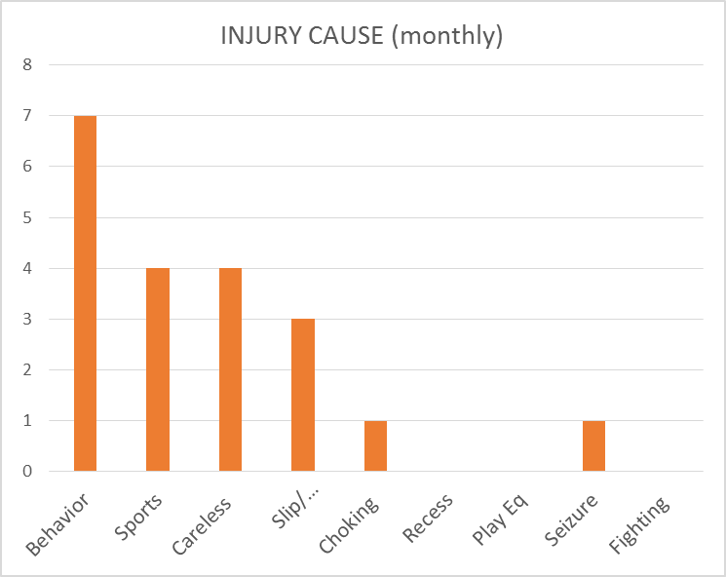
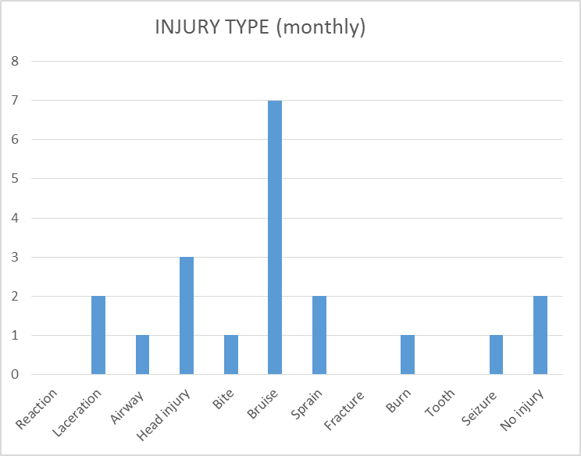
SAFETY CHARTS

